Slide 1
Piecewise Functions
L1.3

Slide 2
Evaluate the function.
$$f\left(x\right)=\left\{\begin{aligned}x−2, if x≤0 \\ 2x+1, if x>0\end{aligned}\right.$$
When $x=−1$
b. When $x=1$

Slide 3

Evaluate the function.
$$f\left(x\right)=\left\{\begin{aligned}x−2, if x≤0 \\ 2x+1, if x>0\end{aligned}\right.$$
When $x=−1$
$$x≤0$$
$$f\left(x\right)=x−2$$
$$=\left(−1\right)−2$$
$$=−3$$
b. When $x=1$

Slide 4

Evaluate the function.
$$f\left(x\right)=\left\{\begin{aligned}x−2, if x≤0 \\ 2x+1, if x>0\end{aligned}\right.$$
When $x=−1$
$$x≤0$$
$$f\left(x\right)=x−2$$
$$=\left(−1\right)−2$$
$$=−3$$
b. When $x=1$
$$x>0$$
$$f\left(x\right)=2x+1$$
$$=2\left(1\right)+1$$
$$=3$$

Slide 8
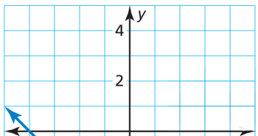

Slide 17
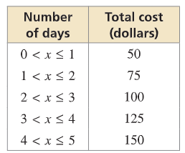
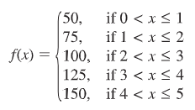
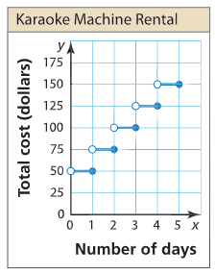
You rent a karaoke machine for 5 days. The rental company charges $50 for the first day and $25 for each additional day. Write and graph a step function that represents the relationship between the number x of days and the total cost y (in dollars) of renting the karaoke machine.
SOLUTION
Step 1 Use a table to organize the information
Step 2 Write the step function
Step 3 Graph the step function

